Slide 1

Supporting The Spectrum.
STRIVE – 9.9.2025
Dr Lee Sturgeon
Strive Ambassador
Consultant Senior Clinical & Developmental Psychologist

Slide 2
Overview
Aim:
  To increase understanding of the autism spectrum.
  To increase understanding and value of autism spectrum inclusive approaches.
  Tips to further build capacity.

Slide 3
ASD –
Some facts
Male: Female = 5:1 (approx.) Females underdiagnosed ?
1983 = 1 in 20,000 (NSW Dept of Ed). 2025 = 1 in 100 internationally. Australia now estimating 1 in 65. USA now suggesting 1 in 45.
Hallmeyer et al 2012. 55% of ASD is now attributed to environmental factors !
No holistic “treatments” available... An individualised approach is required.
ASD overdiagnosis.

Slide 4
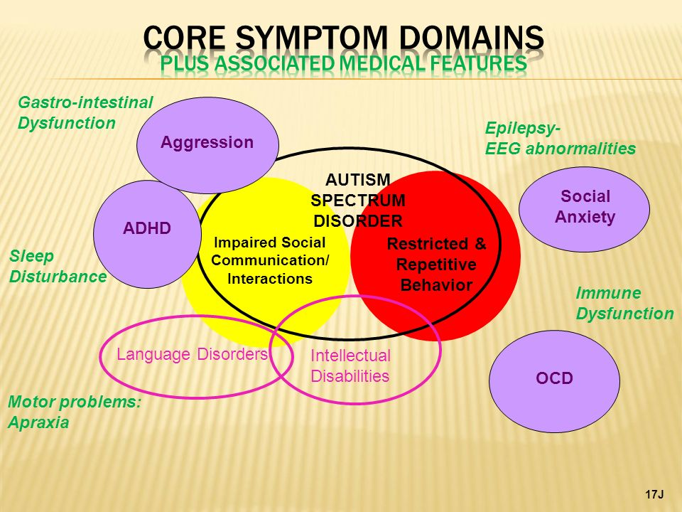

Slide 5
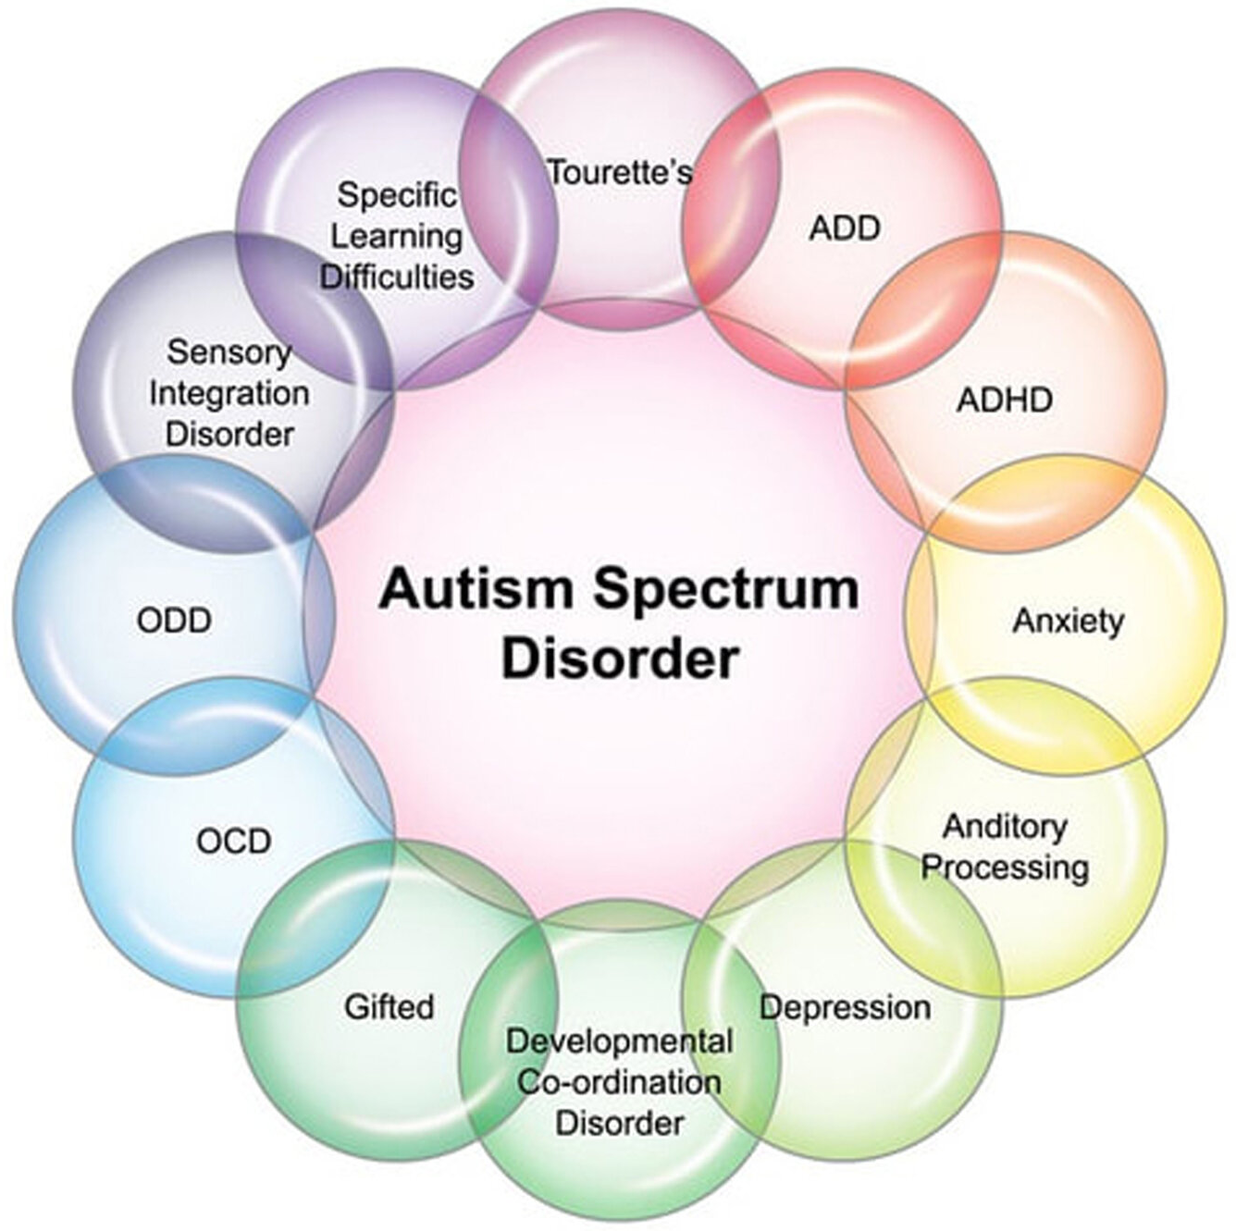

Slide 6
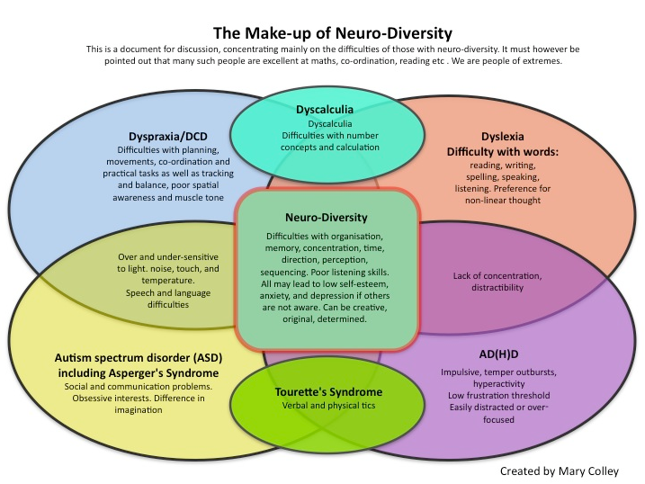

Slide 7
The Diagnostic Process
Look beyond ASD . . . What other diagnoses?
Start Early . . .most parents are correct with their concerns.
Focus on what supports a potential diagnosis can offer (e.g. NDIS funding, Early Intervention, Carer’s Allowance, Companion Card)
Apply for NDIS

Slide 8
Professional Experiences
Anxiety management is key. 99.3% of individuals on the spectrum experience clinical anxiety.
Start Early . . . Access the community . . . get out of the house!
Engage multidisciplinary supports (ie. Speech Pathology, Psychology, OT, GP, Paediatrics). Other professionals depending on additional diagnoses.
Manage technology. Set limits EARLY
Pick one or two primary goals . . . Not a ‘shot gun’ approach.

Slide 9
Professional Experiences
Create Predictable Routines (NOT 100% of the time)
Children with autism often thrive on structure. Having regular routines around meals, school, and bedtime can reduce stress and meltdowns.
Focus on Strengths, Not Just Challenges
Celebrate your child’s unique interests and abilities. Building on their strengths helps with confidence and motivation.
Use Clear and Consistent Communication
Visual supports (pictures, schedules, gestures) can reduce anxiety and help your child understand expectations. Consistency builds security.
Break Tasks into Manageable Steps
Chunking big tasks into smaller steps (with visual or verbal prompts) makes learning and independence easier.

Slide 10
Professional Experiences
Encourage Social Connections at Their Pace
Support friendships in environments that match your child’s interests (e.g., Lego club, gaming, art). Don’t force—it’s about quality, not quantity.
Prioritise Sensory Needs
Notice how your child responds to lights, sounds, textures, and smells. Create calming spaces and offer tools like noise-cancelling headphones, fidgets, or compression clothing if helpful.
Model and Teach Emotional Regulation
Practice calm-down strategies together, like deep breathing, movement breaks, or sensory tools, so they can learn what works for them.

Slide 11
Professional Experiences
Embrace Neurodiversity
See autism as a different way of experiencing the world, not something to “fix.” Acceptance, patience, and advocacy help your child thrive.
Work Closely with Educators and Therapists
Share insights about your child’s strengths and triggers. Collaboration ensures strategies are consistent across home and school.
Take Care of Yourself Too
Parenting a neurodivergent child can be demanding. Access respite, support groups, relatives supports, & self-care routines so you can show up as your best self.

Slide 12
Professional Experiences
Manage extended family.
Plan, keep it short, accept the quirks.
Remember the siblings
Siblings are often overlooked as parents are pressured to attend appointments etc.
Parental mental health.
Talk to your GP. Seek professional supports for yourself.

Slide 13
Resources
www.amaze.org.au
The Loving Push – Temple Grandin
www.autismawareness.com.au

Slide 14


